Slide 1
Impact of an Explicit Health Benefit Plan on Support for Universal Health Care
By: Sean Duan

Slide 2
Why this project?
Health Care in the U.S. is broken
UHC works for other countries
Drug costs out of control
Medical costs most common cause of bankruptcy (Galvani et al 2017)
Spend less, better outcomes
Drug price negotiation
Increase in population insured

Slide 3
Why this project?
Opposition to UHC
Health Benefit Packages solves these (HBP)!
Too complicated!
Hard to define!
Too expensive??
Explicit entitlements
Public facing rules
Budget limits
Transparent requirements

Slide 4
Research Questions
What:
Why:
Does HBP > UHC Support?
Moderating Factors > UHC Support?
Best way to > UHC support?
?s on what leads to > UHC Support

Slide 5
Hypothesis
HBP > Equality / Understanding
Equality > More UHC Support
Easy to Understand > More UHC Support

Slide 6
Pilot Study

Slide 7
Participants
Total N = 185
Age (SD): 18.44 (0.772)
Female % (n): 64.8% (120)
White % (n): 82.7% (153)
Year of School % (n):
Freshman: 59.4% (110)
Sophmore: 35.1% (65)
Junior: 3.7% (7)
Senior: 2.7% (3)

Slide 8
Method: Design
2x3 mixed subjects design
Multi level model
Measurement Time > Subject
Independent variable
Time of measurement (pre/post intervention)
Experimental condition (control/active/passive)

Slide 9
Method: Materials
Choosing Healthplans All Together (CHAT) exercise (Danis, Biddle, & Goold)
“Blank” version – Active
“Filled” version – Passive
“Pizza” version - Control

Slide 10
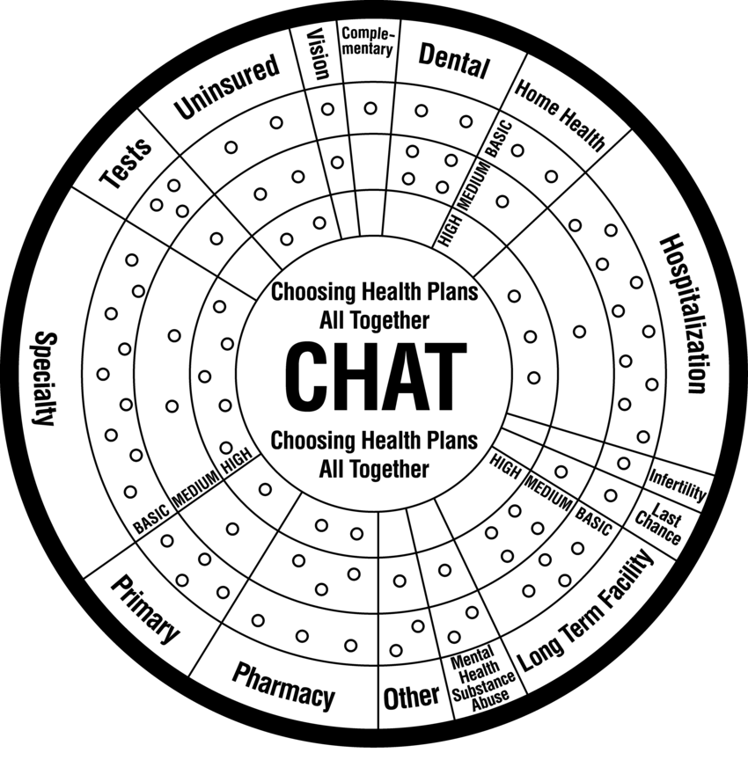

Slide 15
Method: Measures
Pre-Test
Support for Universal Health Care (Shen & Labouff)
Post-Test
UHC support
Qualitative response: Feelings about activity
Likelihood to want UHC plan
Pay for Insurance (Y/N)
Have ever been uninsured (Y/N)

Slide 16
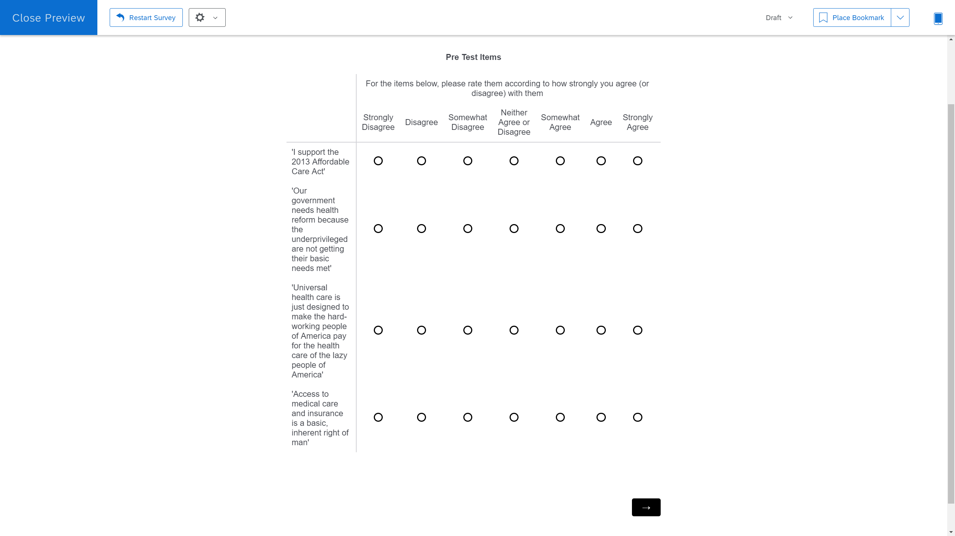

Slide 17
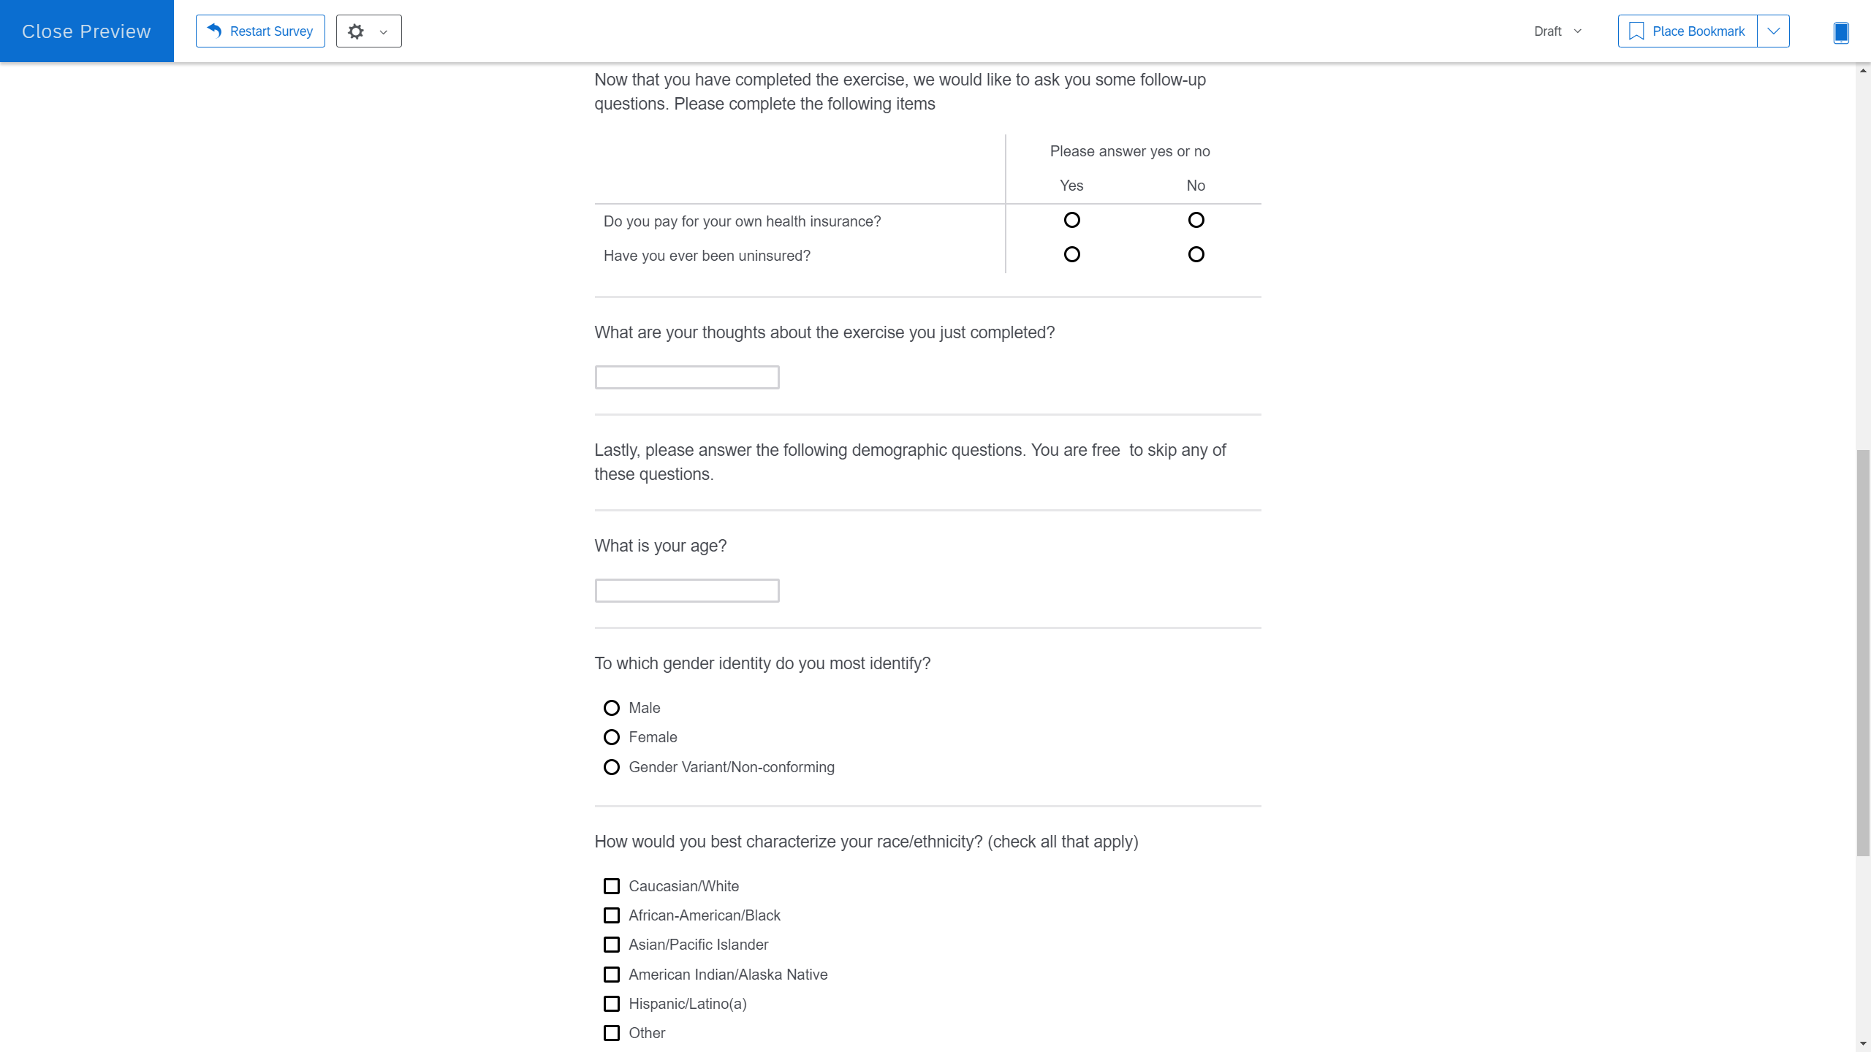

Slide 18
Method: Procedure
Cubicle with Qualtrics survey
Pre-test measures given
Randomization
Control
Intervention
Active
Passive
Post-test measures given
Debrief

Slide 19
Results – Study 1

Slide 20
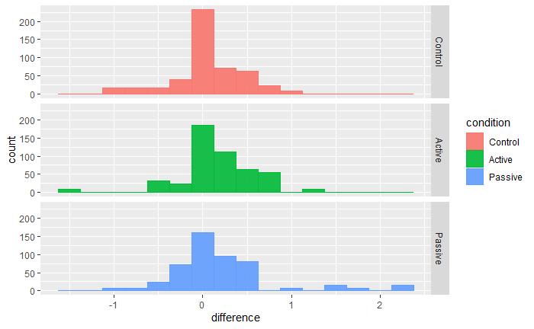

Slide 21
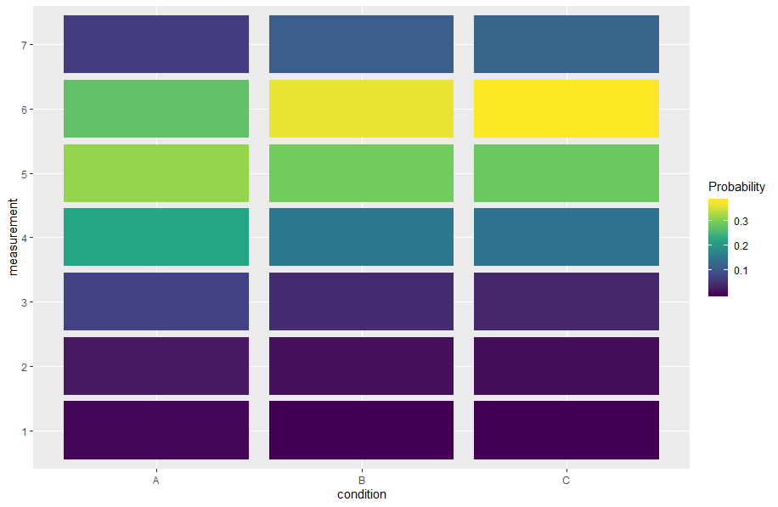
Control
Active
Passive

Slide 22
Quantitative Results
Intervention > Increased UHC Support!
Active = Passive intervention?
Time Spent =/= UHC support

Slide 23
Qualitative Results
“ What are your thoughts about the exercise you just completed?”
Confusion? – 10%
“It was a little confusing if you aren't very familiar with insurance and health care.”
Interesting! – 32%
“It was hard to choose because some of the parts in the insurance plan would've been nice to have but no necessary for me personally.”

Slide 24
What to change for Study 2?
Reduce # of conditions > More Power
Better Control > External Validity
Measure moderating factors
Simpler materials > Less confusion

Slide 25
What did we change?
Control and Intervention only
Control – “Standard” UHC messaging
Moderating Factors
Complexity
Equality/Fairness
Javascript CHAT exercise
Sliders > Likert measures

Slide 26
Study 2

Slide 27
Method: Design
2x2 mixed subjects design
Multi level model
Measurement Time > Subject
Independent variable
Time of measurement (pre/post intervention)
Experimental condition (control/HBP exercise)

Slide 28
Method: Materials
Choosing Healthplans All Together (CHAT) exercise (Danis, Biddle, & Goold)
Web-exercise version
‘Traditional’ UHC information
Pamphlets from WHO

Slide 29
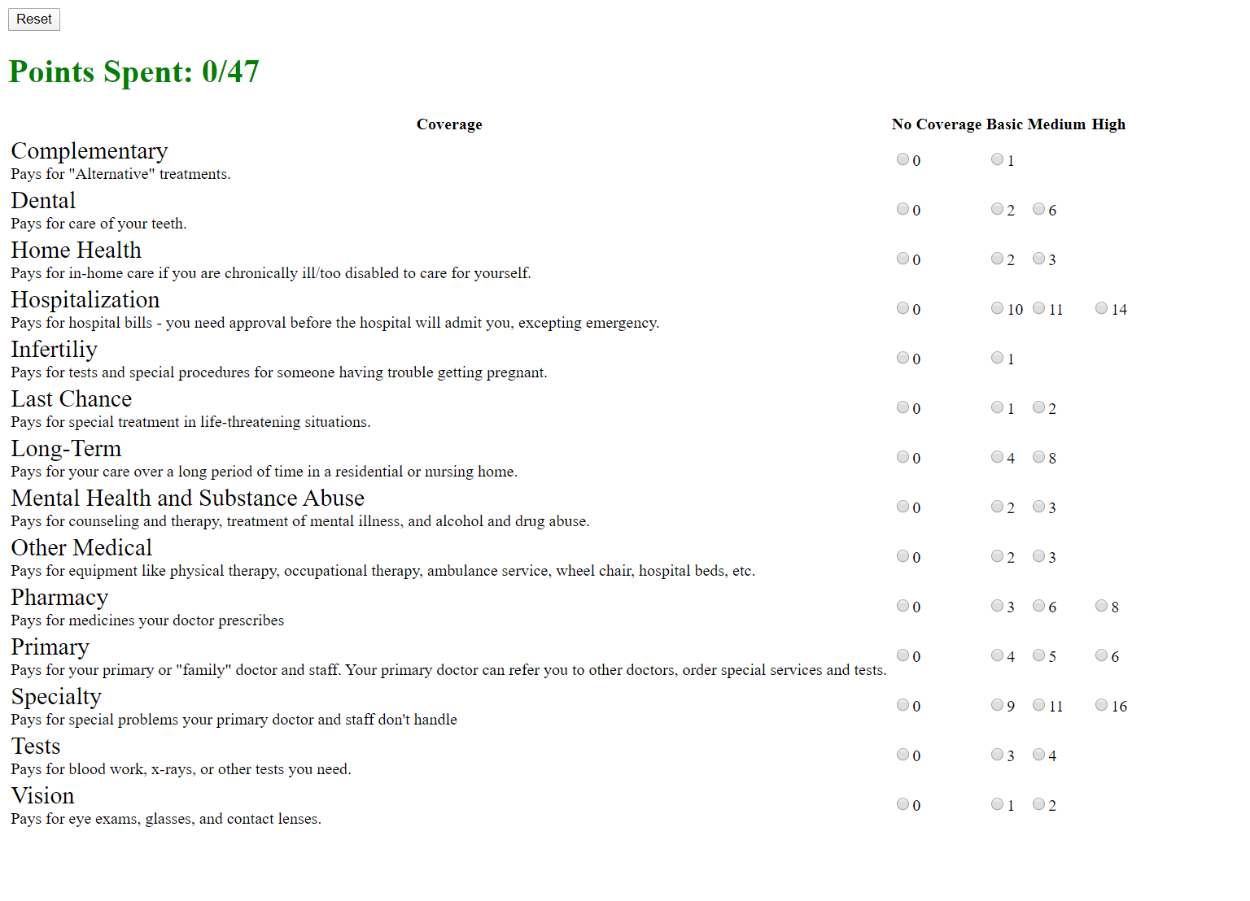

Slide 30


Slide 31
Method: Measures
Pre-Test
Support for Universal Health Care (Shen & Labouff)
Post-Test
UHC support
Qualitative response: Feelings about activity
Likelihood to want UHC plan
Pay for Insurance (Y/N)
Have ever been uninsured (Y/N)

Slide 32
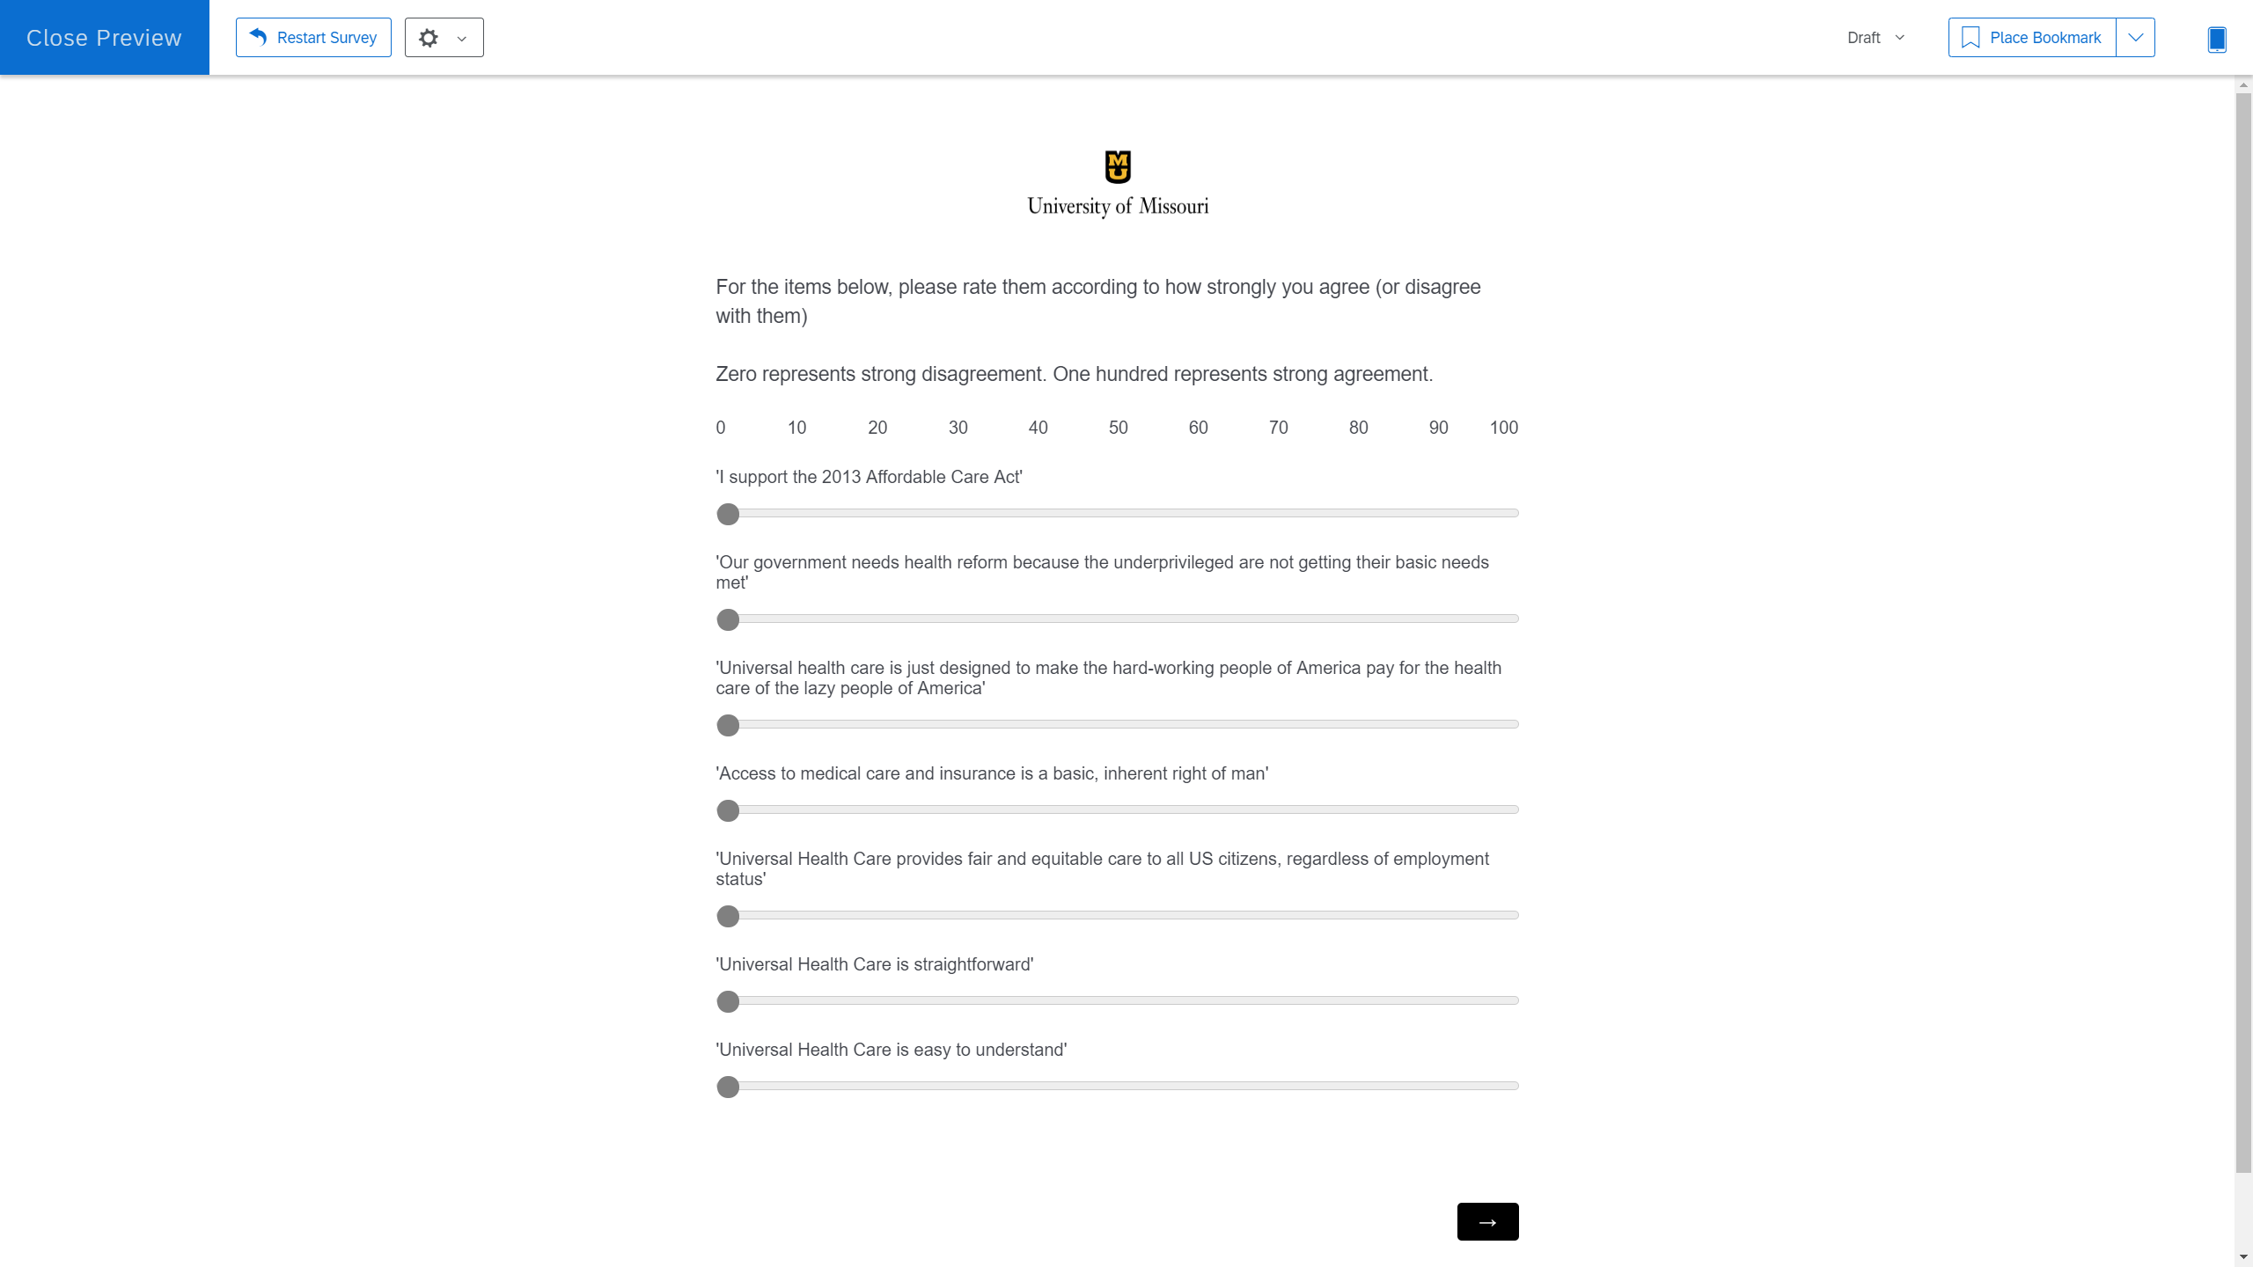

Slide 33
Method: Procedure
Cubicle with Qualtrics survey
Pre-test measures given
Randomization
Control
3 UHC infographics – 40 sec minimum each
Intervention
Facilitator sets up/provides printed material
HBP activity in separate screen – 120 sec minimum
Printed HBP ‘legend’
Post-test measures given
Debrief

Slide 34
Method: Modelling
Multi-level model
Time nested within Subject
Comparisons
Time x Condition > Support UHC
Condition > Moderating factors?
Moderating factors > Support UHC?

Slide 35
Method: Modelling
Variable Selection
Theoretical reason for variable
Time (pre/post)
Total time spent
Subject (is this actually a variable?? Check )
Condition
Moderating factor scores
(maybe remove this slide?)

Slide 36
Extensions?
More structured qualitative analysis
Better measures of moderating factors
Online only version through javascript
Compare results of Post corona data to Pre corona data?

Slide 37
Conclusion
HBP seems effective
Want to see it replicate under conditions of > external validity
CHAT exercise too complex as initially designed

Slide 38
Questions?

